Slide 1


Starting out with Python
W200 Introduction to Data Science Programming
Week 02
Summer 2021

Slide 2

Agenda
1. Recap of last week and questions
2. Running Python
3. Expressions
4. Objects
5. String Objects (& Breakout)
6. Control of Flow (& Breakout)

Slide 3
1. Checking in …
Are your environments set up okay?
Homework assignments are posted on GitHub "upstream" on Monday evenings
TA grade and provide feedback on homework; Instructors may review; Instructors grade & provide feedback on projects
Make sure you’re using Python 3.x (3.6 higher).
GitHub ready to go?
Bash info: [http://hyperpolyglot.org/unix-shells]
There are optional intros to Unix commands in the Optional Resources folder.

Slide 4
1. Ask your questions
Reminder of communications channels
Check out the TAs and OH.
Syllabus Link
Live Calendar
Homework Assignments
Email instructors & students: w200-python-2021-summer@googlegroups.com
Email instructors only: mids-python-instructors@googlegroups.com
Slack Channels: ucbischool.slack.com channel #w200-python

Slide 5
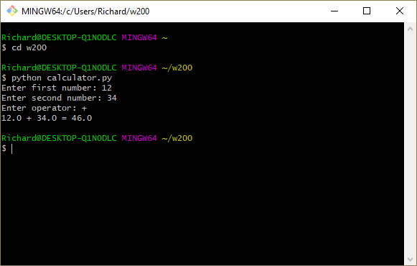
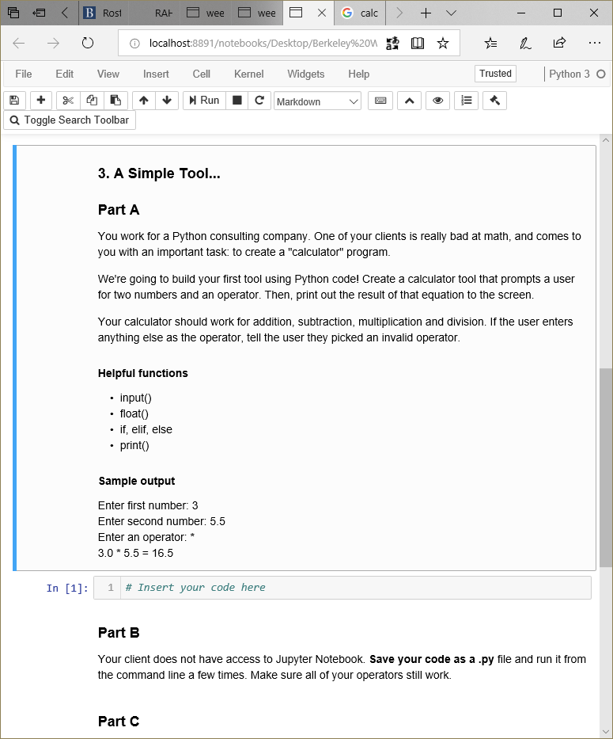
2. Running Python (reminder)
Command line
Use a text editor [Atom, BBEdit, NotePad++; and save as a .py file. You may need to specify >python3 myfile.py if you have multiple versions installed.
Jupyter Notebook
App that interprets and provides error msgs. Useful for testing - be sure to reload variables and remember that instructors don’t have access to your hard drive.
Be sure to restart the kernel and re-run your homework before you submit it.
Check out Jupyter Notebook; PyCharm & Spyder websites

Slide 6
3. Expressions
Building blocks reminder.
Assignment |  | x = 5
Addition | + | x + 5
Subtraction | - | x - 5
Division | / | x / 5
Multiply | * | x * 5
Exponent | ** | x ** 5
Cumulative | += | x += 5 x = x + 5
Equivalency |  | x == 5
Cumulative | -= | x -= 2
Integer division | // | x // 5
Modulus | % | x % 2

Slide 7
4. Concepts about Objects
More about objects later but let’s start with some principles.
What is an “object”?
a programmatic way of expressing things in the physical world* of the time you’ll have to discover answers on your own (that’s how it is in computing).
For OOP languages …
the “object” is the parent, from which child objects are copied and used; these child copies are the instantiation of the Object. In coding the “Object” becomes a “Class.”
Everything in Python is an object. All objects …
(a) contain all their variables and behaviors [methods] [encapsulation],
(b) can accept multiple parameters [polymorphism], and
(c) can be copied and new properties added [inheritance].
Communication between Objects isn’t necessarily linear: they can send messages to/from each other, given appropriate triggers.
In OOP there’s a hierarchy of libraries; going up the chain of a command leads ultimately to the base Object; from there we can traverse a chain back down to another type of object (hence “type-casting”).
Rather like Plato’s Theory of forms, De re publica, Book 10.

Slide 8


# a coin-toss program
import random # an external library
class Coin:
# defining our own classes
# a magic method python has for constructing an object in memory
def __init__(self):
self.sideup = "Heads"
# toss method generates a random number in the range of 0-1. if 0,
# then sideup is heads; else it's tails.
def toss(self):
if (random.randint(0, 1) == 0):
self.sideup = “Heads"
else:
self.sideup = "Tails"
# create a function to get the value
def get_sideup(self):
return self.sideup
# define the MAIN function
def main():
# create a variable (the object “Coin” from the Coin class).
my_coin = Coin()
# display the side of the coin that’s facing up
print("This side is up:", my_coin.get_sideup())
# toss that coin!
print("I'm tossing the coin … ")
my_coin.toss()
# show the results …
print("This side is up: ", my_coin.get_sideup())
# all done creating the 'legos' of our code, now let's start the show…
main()
# end of the file.
Class
variables
methods()
1) “construct” the Coin;
set to “heads”
2) define actions (“methods”) that do something with the Coin (here, just “toss”)
3) more methods: find out what side is up
get_sideup()
Use “main” to organize events.
Define a door into the program (main).
Create the “Coin” (so we have one to play with).
Use the pre-defined actions methods on the coin instance.
OPTIONAL ENRICHMENT

Slide 9

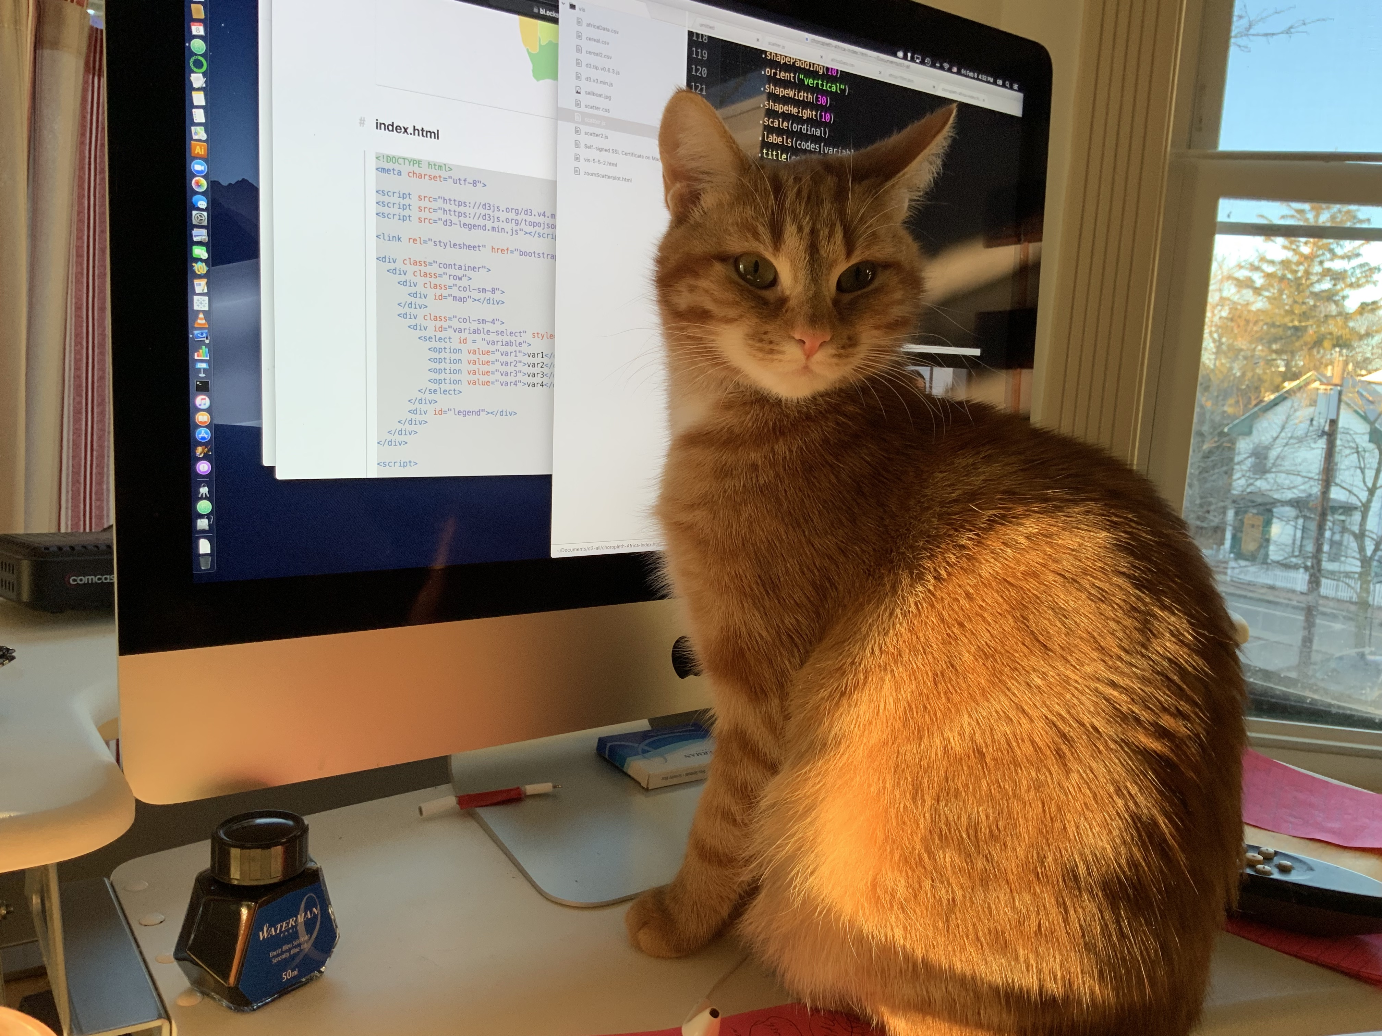
4. Objects
conception from ideas into executable code
Objects reflect “real-world” phenomena. Here is my cat … expressed in computer code as a Cat object.

Slide 10
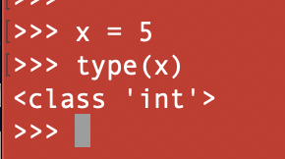
4. Objects have types
Everything in python is an object; we can get info about the object as well as its values.
Python lets us assign values and we can test what data type we’re using, e.g., x = 5 → type(x) → returns int
Boolean [bool, true/false; 0/1]
Integers (int) counting numbers
Floating point (float), e.g., 3.14159
String (str), a sequence of contiguous characters, e.g., [c][a][t]
Type cast: convert data from one type to another, e.g., float(x)
st = input(“Enter some text: ”) #Default is string
fl = float(input(“Enter data: ”)) #Convert to float

Slide 11
# -*- coding: utf-8 -*-
""" a little nested if script """
""" since python defaults to ASCII unless otherwise informed ... we like UTF-8 """
""" can you get a loan to work remotely in Tahiti? I sure would like to! """
min_salary = 50000.0 # min salary to get loan
min_years = 2 # min years on the job
# get the annual salary
salary = float(input("Enter the annual salary: $ "))
# years on the job
years_on_job = int(input("and the number of years on the job? "))
# check conditions
if salary >= min_salary:
if years_on_job >= min_years:
print("\n\tJoy! Tahiti here we come!\n")
else:
print('Sorry! The minimum is ', min_years,' to qualify.')
print("Treat yourself to a consolation peña colada on us.")
else:
print("Annual income must be at least $", format(min_salary, ',.2f')," to qualify.")
Notes:
Encoding directive utf-8. Often automatically added by some IDEs.
Python “”” style comments.
Defining some global variables (min_salary and min_years)
Get input from the stdin (keyboard) and converting the input into a float or int type.
Nested-if statements. Notice the range checking, use of escape-sequences \n\t and format commands.
print() sends data to the currently selected stdout.
OPTIONAL ENRICHMENT

Slide 12
5. Namespaces | Object space
Think of the variable name as what we call it; but that var can point to different values in RAM the object space
The concept of a “namespace” refers to the active set of variables, as we name and use them in our code. Using a namespace usually keeps variable names unambiguous.
Common in SQL, C++, etc., referring to the scope & visibility of a variable.
In python, we can have several variables of different names share the namespace … but they can all point to the same value in object space.
For students with experience in other languages, see the parallels:
C++ example
// Here we can see that more than one variables
// are being used without reporting any error.
// That is because they are declared in the
// different namespaces and scopes.
#include <iostream>
using namespace std;
// Variable created inside namespace
namespace first
{
int val = 500;
}
// Global variable
int val = 100;
int main()
{
// Local variable
int val = 200;
// These variables can be accessed from
// outside the namespace using the scope
// operator ::
cout << first::val << '\n';
return 0;
}
SQL Example
SQL (Entity SQL) uses “namespaces” to avoid conflicts for global identifiers, such as type names, entity sets, functions.
E.g.: a database has 3 tables, A, B, and C. Each table has a “record_number” field. To distinguish them we use the table . field:
A.record_number = 50
B.record_number = 233
OPTIONAL ENRICHMENT

Slide 13



5. Namespaces | Object space
Variables go into a special object called a “name space.” This is related to ”variable scope".
vari-able
name space
object space
var
name space
object space
x
x
5
int
b_int
b_int
36
file
c_int
c_int
int
But without a namespace we can’t reach elements in the object space
greet
greet
print(“Bonjour”)
function

Slide 14
6. Objects: Strings
Once we learn the syntax of an object, it’s easy to anticipate its methods.
A String is a “sequence object” [imagine the memory address of this string is 0 and is n bytes long. - Locate entire strings, individual letters, range of letters]
Strings can be joined (or “concatenated”) and manipulated:
concatenation: “cat” + “dog” outputs “catdog”
multiplication of chars: “-”*5 outputs —————
<string>.upper(), e.g., x = “cat” print(x.upper())
<string>.lower()
s = input(“Type here:”)
int_cast = int(input(“write a number: ” ))
Python gains a lot of speed by using “pointers” and like many languages, the pointers are hidden from the programmer. [No issues of malloc and referencing points!] Notice that as an OOP language, Python often uses String methods (. and ()) to copy, adjust, and then replace the object in RAM, using the same variable name.

Slide 15
Optional: A side note.
RAM (random access memory) looks like a grid. Every wire on the x-axis that crosses the wire on the y-axis creates a memory address. There are two registers: address and data.
The data are stored by being encoded and decoded (pointers and dereferencing pointers; may include casting object into other data type, often as String).
So … when a Python variable (object) is stored in RAM, our variable “point” to the object’s memory address in RAM. A copy of the variable has a different name but still points to the same memory address. This is important.
If we have a = 5 and then b = a, both a and b refer (point) to the same memory address. Consequently, changing the value of “b” changes the value of “a”.
This might cause a problem in your coding. We’ll see this addressed in the idea of “scope and visibility” of our variables and in certain Python commands, such as copy versus deepcopy.
(But it is cool how our code is so intimate with the chip!)
OPTIONAL ENRICHMENT
Strongly recommended: read
Sipser, M., Introduction to the theory of computation. (3rd ed). A pdf earlier version is here.
http://www.righto.com/2017/07/inside-intels-first-product-3101-ram.html

Slide 16
6. String Objects
Python is fairly loosely typed; note “straight” quotes versus “typographers’ quotes”.
Single- and double quotes:
Python, like other loosely-typed languages, allows using single- and double-quotes around Strings. Keep in mind that often when concatenating data we use a mix of " and ' … the use of these must be balanced, else a hard to find error.
Comments in python code use three ", e.g., """
\ means an “escape sequence”, note: \n, \r\n, \t
' ' # single quotes (the dagger kind)
" " # double quotes (notice the pairing)
t = input("Welcome, you're here! ")
# double quotes surrounding string
# so the single quote is safe
s = input('Welcome, you\'re here!’)
# single quotes, so middle one needs
# to be "escaped"

Slide 17
5. String Objects: Slicing
Slicing, like many python commands, has lots of shortcuts.
p
y
t
h
o
n
!
0
1
2
3
4
5
n
[0] | from the start of the string
[-1] | one letter from the end of the string
[0:3] | from the start of the string to the 4th letter
[1:-1] | from 1 to the next to last letter
[1:5:2] | from 1 to 5, by 2 at a time
[:-1] | beginning (:) to second to last letter (n - 1)
[:] | entire string
[::-1] | entire string, reversed
“Slicing” is surprisingly
important in data sci and
processing of data,
during “data cleansing.”
We rely in slicing to test data
before ingesting, to test data
for certain conditions …

Slide 18

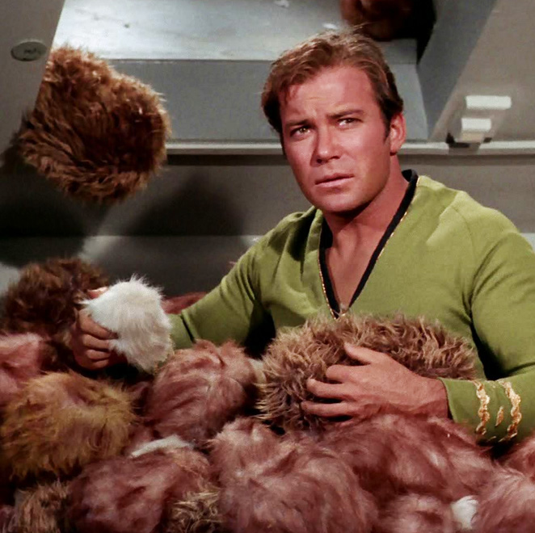
Breakout Activities:
Tribbles, Spiders, and Calculator
Use what you downloaded for week 2 in Jupyter to create a string variable that prints exactly
Using one line of Python code, make your variable from part 1 print Tribbles backwards “selbbirT” 300 times.
The “trouble with
Tribbles” is that they
\\\EAT/// too many MREs.
selbbirT selbbirT selbbirT …

Slide 19
6. Flow Control: if, while
Review of the basics
if x > 2:
print(“x is greater than 2”)
elif x < 0:
print(“x is negative”)
else:
print(“x is less than 2 but still positive”)
if statements & nested if statements
while loops
We’ll see several other techniques next week, such as for x in range(), when we work with lists and dictionaries.
countdown = 5
while countdown > 0:
print(countdown)
countdown -= 1
print(“Blast off!”)
Notes:
Discuss: This slide is deceptively fun! Try asking your students “what happens in the ‘if’ statement if x == 2 ☺
I use this as a way to discuss how there are both ‘coding’ errors, and ‘conceptual’ errors (the code works, but does the wrong thing!)

Slide 20
An example of using for loops in various functions … basic Python [1 of 2]
""" a for-loop demo """
""" for-loops are a count-controlled lop, iterating sequentially over a
set of data, e.g., an array or other set of data """
def aboutThisScript():
print("-"*60)
print("This script will iterate over a set of integers, Strings, \nand then "\
"use a function in the iteration for new values ")
def allDone():
print("\nCheck out the script for little demos. That's it. Cheers.\n")
def iterateInts():
print("-"*60)
for i in [1, 3, 5, 7, 9, 13, 17]:
print("Prime number: ", i)
def iterateStrings():
print("-"*60)
for name in ['Tom', 'Ming Wa', '明哇', 'विक्रम', 'Rex', 'Fatima', 'Kelly' ]:
print(name)
def squareValues(i):
return i^2
def iterateFunc():
print("-"*60)
print("Squaring values from a list.\n")
list_1 = [6, 3, 1, 4, 5, 1]
for i in list_1:
print("\t", squareValues(i) )
OPTIONAL ENRICHMENT

Slide 21
Ultimately we’ll move to anonymous, lambda functions … basic Python [2 of 2]
def lambdaMapDemo():
""" notice we're walking from scalars (for loops) to
vectorization -that is being able to make looping more
efficient by coding to let python use pointers (variables
that point to memory addresses holding the actual values);
we don't use actual pointers as in C++ but we write code
that let's python do so for efficiency. """
list_2 = [1, 2, 3, 5, 8, 13, 21 ]
""" notice the reading from left to right... the source of the data is list_2;
Then each value is squared. The lambda "maps" each value sequentially as "x"
to the calculation; then stores all the results in a NEW list, squaredFib.
"""
squaredFib = list(map(lambda x: x*2, list_2))
print("-"*60)
print("Here is a list of values squared of ", len(list_2), " values.", sep="")
print(squaredFib)
# ********************************************************
#
# Above each of the actions are defined in functions; we want, tho, to
# demonstrate iterating using for loops and various data. Now that the
# code pieces "legos" I call 'em are all set, now let's call them in order
# in our main function. Finally we invoke main to start the process.
#
# *********************************************************
def main():
aboutThisScript()
iterateInts()
iterateStrings()
iterateFunc()
lambdaMapDemo()
allDone()
# invoke the script starting here.
main()
OPTIONAL ENRICHMENT

Slide 22
6. Nested while loops
don’t worry about perfect spacing
row = int(input(“Enter an integer: “))
# while row >= 0:
j = 0
while j <= row:
print(j, end=“ “)
j += 1
Enter an integer: 5
0 1 2 3 4 5
row = int(input("Enter an integer: "))
# outer loop
while row >= 0:
j = 0
#inner loop
while j <= row:
print(j, end=" ")
j += 1
print(" ")
row -= 1
Enter an integer: 5
0 1 2 3 4 5
0 1 2 3 4
0 1 2 3
0 1 2
0 1
0

Slide 23
""" a little script showing boolean flag and a while loop """
keep_going = "y" # a boolean flag - keep going 'til quit. common technique.
# calculate a series of commissions
while keep_going == “y":
# get sales and commission rate
sales = float(input("\nWelcome.\n\tPlease enter the sales amount $: "))
comm_rate = float(input("\tand commission rate: "))
# calculate
commission = sales * comm_rate
# display the commission
print("Commission is $", format(commission, ',.2f'), sep='')
""" keep going? as long as the flag is true, keep going.
note, btw, that by forcing string data to lower()
we don't have to check
for Y and y. Try to validate-on-input to reduce the
amount of code you need.
"""
keep_going = input("\nCalculate another? [y|Y any other key to quit.] ").lower()
OPTIONAL ENRICHMENT

Slide 24

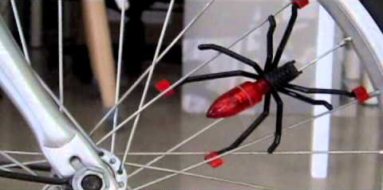
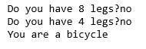
Breakout Activities: Spiders
https://www.youtube.com/watch?v=DVAkVwy4TD4

Slide 25

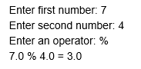
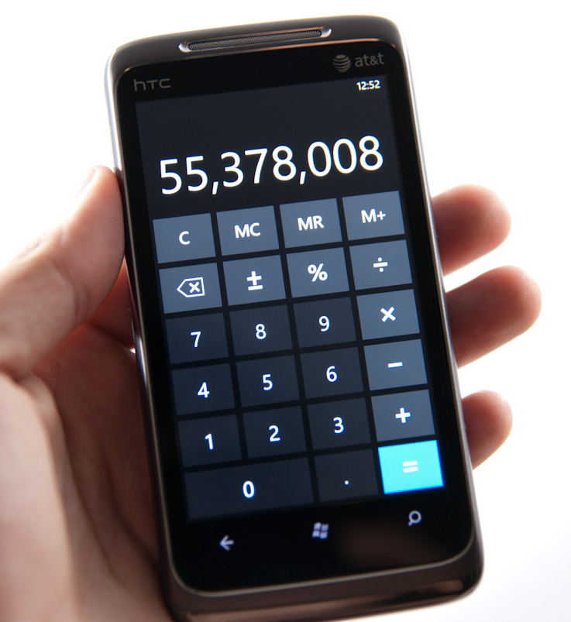
Optional Breakout: Calculator
Make a calculator - the purpose is to practice conditions (“if” statements) and saving your work as a .py and executing it.
https://www.clayallsopp.com/posts/definition-of-design-terms/

Slide 26

That’s it!
That’s it! Enjoy a great week and keep up with your drills and homework assignments.

